Slide 1
Chongqing University of Technology
ATAI
Advanced Technique of Artificial Intelligence
Chongqing University of Technology
Correlation Networks for Extreme Multi-label Text Classification
Guangxu Xun, Kishlay Jha, Jianhui Sun, Aidong Zhang et al(KDD-2020)
2020.11.1 • ChongQing
Reported by Lele Duan
Code&dataset:https://github.com/XunGuangxu/CorNet

Slide 2
Chongqing University of Technology
ATAI
Advanced Technique of Artificial Intelligence
Chongqing University of Technology
1.Introduction
2.Method
3.Experiments
4.Conclusion

Slide 3
Introduction
Chongqing University of Technology
ATAI
Advanced Technique of Artificial Intelligence
XMTC
Label set : Millions of labels
Deep XMTC models ignore the useful correlation information among different labels.
CorNet addresses this limitation by adding an extra CorNet module at the prediction layer of a deep model
Choosing some most relevant tags for the item from Millions of labels
item

Slide 4
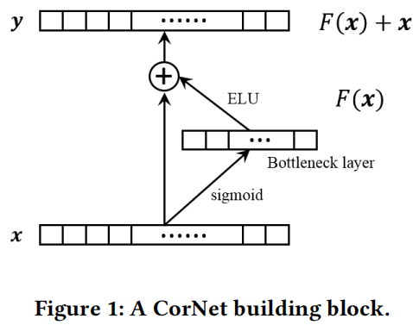
Method
Chongqing University of Technology
ATAI
Advanced Technique of Artificial Intelligence
CorNet building block is defined as:
𝐹 stands for the underlying mapping function.
𝒙 denotes the raw label predictions before the CorNet block
𝒚 denotes the enhanced label predictions after the CorNet block
where 𝑾1, 𝑾2 are the weight matrices, 𝒃1, 𝒃2 are the biases

Slide 5
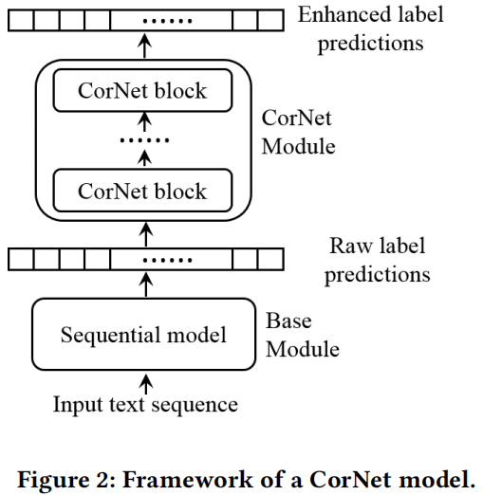
Method
Chongqing University of Technology
ATAI
Advanced Technique of Artificial Intelligence
Actually 𝒙 could also be the output label predictions of a previous CorNet block
So more complicated label correlations can be captured by the deep CorNet module
CorNet is a general architecture and it can be concatenated after any standard deep XMTC architectures

Slide 6
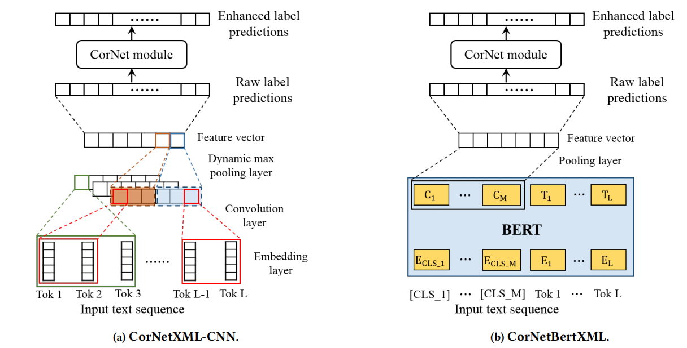
Method
Chongqing University of Technology
ATAI
Advanced Technique of Artificial Intelligence

Slide 7
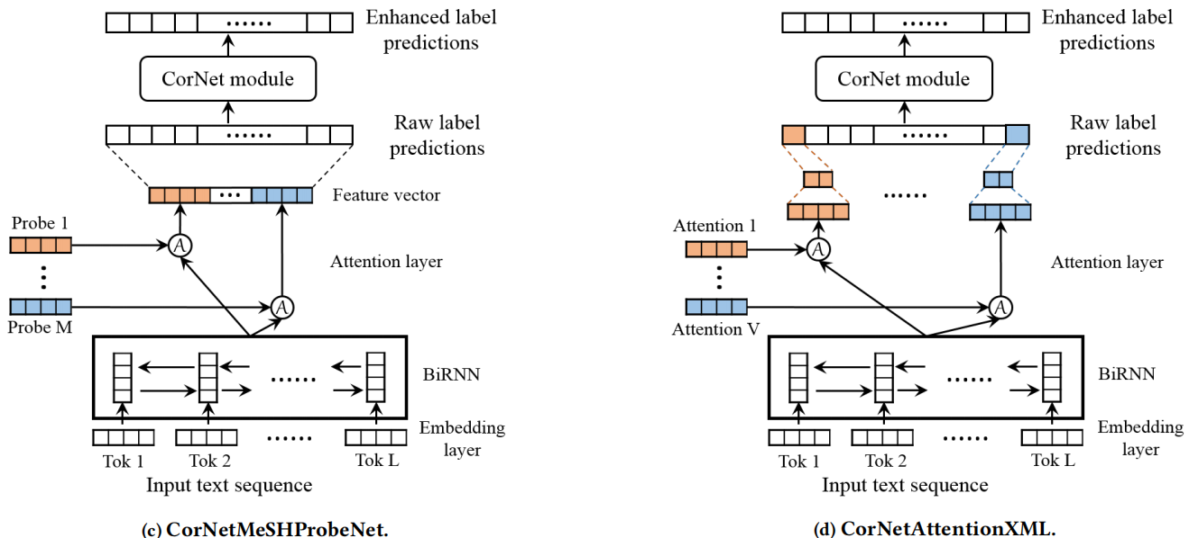
Chongqing University of Technology
ATAI
Advanced Technique of Artificial Intelligence
Method

Slide 8
Chongqing University of Technology
ATAI
Advanced Technique of Artificial Intelligence
Experiments
Evaluation Metrics
The precision at top k (precision@k)
The normalized Discounted Cumulative Gain at top k (nDCG@k).
Let 𝒛 ∈ ${\left\{0,1\right\}}^{L}$denote the ground truth label vector of an instance and 𝒛ˆ ∈ $R^{L}$ denote the model predicted score
$r_{k}\left(\hat{z}\right)$is the ground truth indices corresponding to the top k indices of the model predicted rank list
${\left|\left|Z\right|\right|}_{0}$counts the number of ground truth labels for this instance.

Slide 9
Chongqing University of Technology
ATAI
Advanced Technique of Artificial Intelligence
Experiments
Performance Comparison
In order to make the performance comparison as fair as possible, we assign the same embedding dimension and hidden size for all models

Slide 10
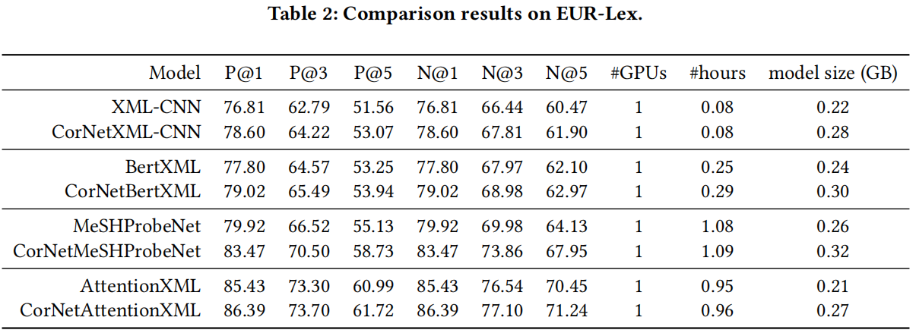
Chongqing University of Technology
ATAI
Advanced Technique of Artificial Intelligence
Experiments
CorNet is able to consistently improve the performance

Slide 11
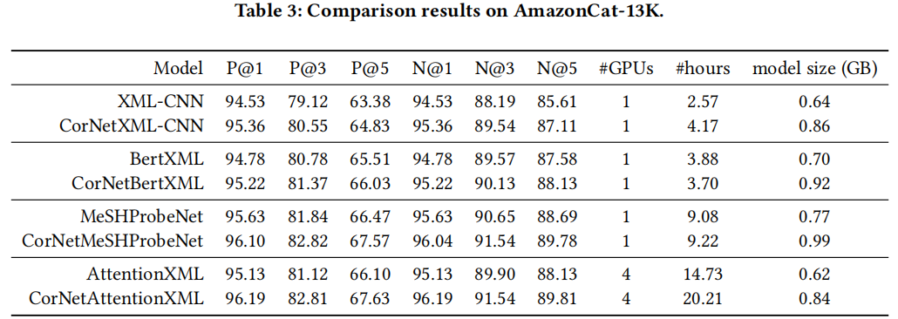
Chongqing University of Technology
ATAI
Advanced Technique of Artificial Intelligence
Experiments
CorNet is able to consistently improve the performance

Slide 12
Chongqing University of Technology
ATAI
Advanced Technique of Artificial Intelligence
Experiments
CorNet is able to consistently improve the performance

Slide 13
Chongqing University of Technology
ATAI
Advanced Technique of Artificial Intelligence
Experiments
Convergence Study
CorNet convergences more quickly

Slide 14
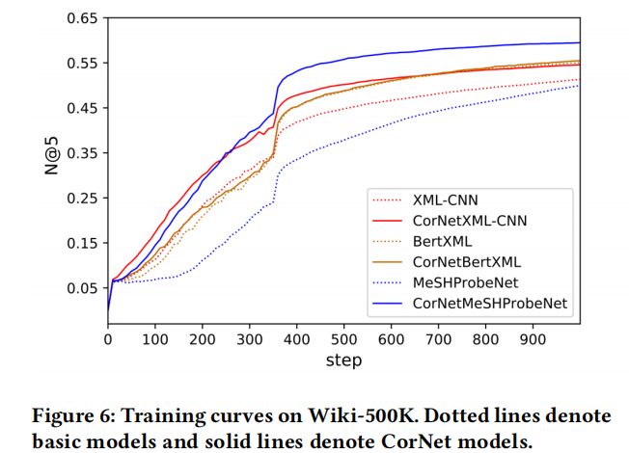
Chongqing University of Technology
ATAI
Advanced Technique of Artificial Intelligence
Experiments
CorNet convergences more quickly

Slide 15
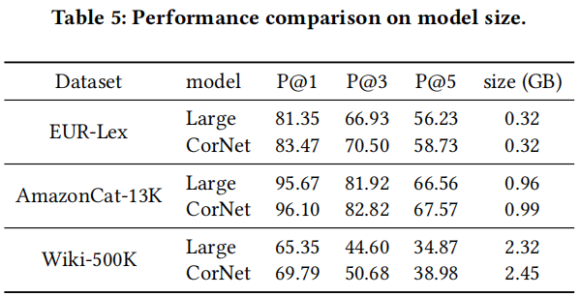
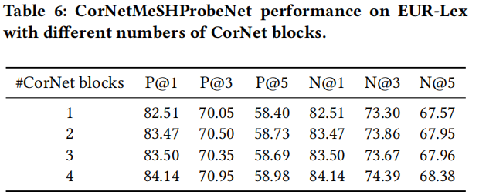
Chongqing University of Technology
ATAI
Advanced Technique of Artificial Intelligence
Experiments
Ablation Analysis
Model Size.
Number of CorNet Blocks.
2 CorNet blocks achieve a good balance between performance and complexity
2 CorNet blocks are used as the default setting in the our experiments.
Large : MeSHProbeNet-large
CorNet : CorNetMeSHProbeNet.

Slide 16
Chongqing University of Technology
ATAI
Advanced Technique of Artificial Intelligence
Conclusion
CorNet is a general and independent architecture that can be directly integrated with any deep XMTC models as an add-on enhancer module.
Extensive experimental results demonstrated the effectiveness of CorNet, which is able to advance the state-of-the-art performance on several different multi-label text classification datasets.
Moreover, CorNet also exhibited the ability to accelerate the convergence rate during training
.

Slide 17
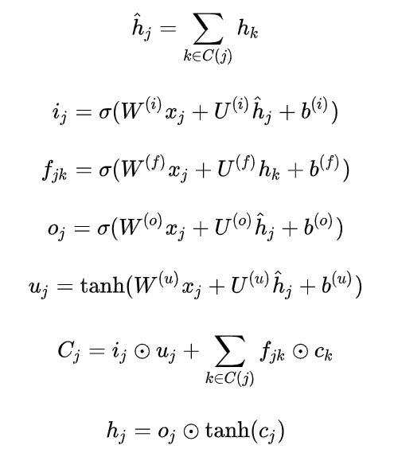
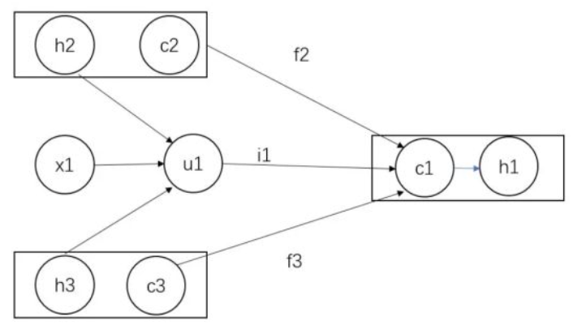
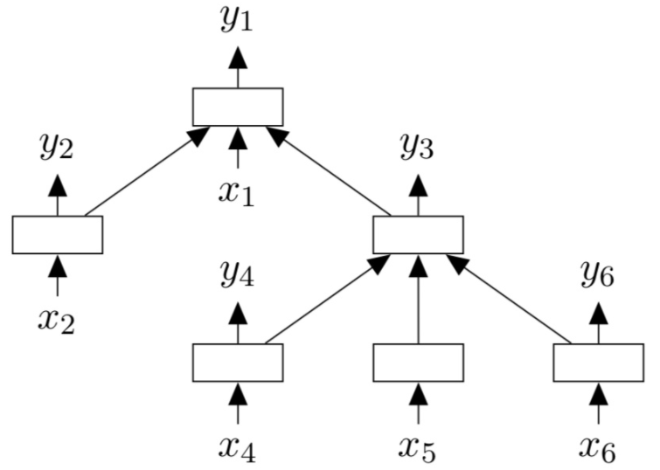
Chongqing University of Technology
ATAI
Advanced Technique of Artificial Intelligence
Tree-LSTM
Child-Sum Tree-LSTM
计算h1示例：
$$u_{1}=W_{1}^{\left(1\right)}x_{1}+U^{(u)}(h_{1}+h_{2})+b^{u}$$
$$c_{1}=i_{1 } u_{1}+\left(f_{2} c_{2}\right)+(f_{3} c_{3} )$$
$$h_{1}=o_{1} tanh⁡(c_{1})$$
标准LSTM的区别:
(1)标准LSTM只用到了上一步神经元的隐藏层输出$h_{t−1}$,但这里需要用到
(2) Child-SUM Tree-LSTM需要多个遗忘门,

Slide 18
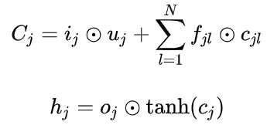
Chongqing University of Technology
ATAI
Advanced Technique of Artificial Intelligence
Tree-LSTM
N-ary Tree-LSTM
branching factor最多是N
子节点有序
对于其任意节点$j$,其第$k−th$个子节点的隐藏状态$h_{jk}和$cell state 为 $c_{jk}$，计算公式如右：
子节点有序

Slide 19
Chongqing University of Technology
ATAI
Advanced Technique of Artificial Intelligence
Chongqing University of Technology
Thank you!

